Slide 1

MILESTONE 1: Planning and Proposal
Project Name: RCCG Website
By: Iyanu Lamina

Slide 2
Project SUmmary
Purpose of the website: It is a means of informing the community about the activities of the church and facilitating outreach efforts to invite people to attend services. The primary purpose of the website is to serve as a platform where members of the organization and other potential users can access information about the church. Additionally, it will offer updates from the organization to keep potential users informed. Moreover, the website is designed to provide new users with the necessary information and guidance on how to locate the church when needed.
The problem it addresses: We are aware that some individuals are unable to attend church physically, and we aim to share the word of God with them primarily through our online services, hosted via social media platforms such as Facebook. What sets it apart from other church websites is our plan to track attendance for each member. This allows us to foster a sense of community, enabling everyone to recognize each other and providing an avenue to reach out to those who couldn't attend church on a particular Sunday."
Why is it important: It serves as a platform to communicate our vision to the public.
Stakeholders: The congregation and potential members, believers in Christ, the general public, developers, and project managers.

Slide 3
USER story 1
Mayowa is a diligent student who faithfully attends church services throughout the week and on Sundays. One day, she wanted to connect with someone from the church but realized she didn't have their contact information. To remedy this, she decided to search for the church website online. Upon finding the website, she discovered that it lacked any contact details. Determined to reach out, Mayowa resolved to inquire about the church's contact information from the pastor or another church executive during Sunday service. She expressed hope that the church would update its website to include essential information, such as a contact form.

Slide 4

UML Diagrams For Use case scenario

Slide 5
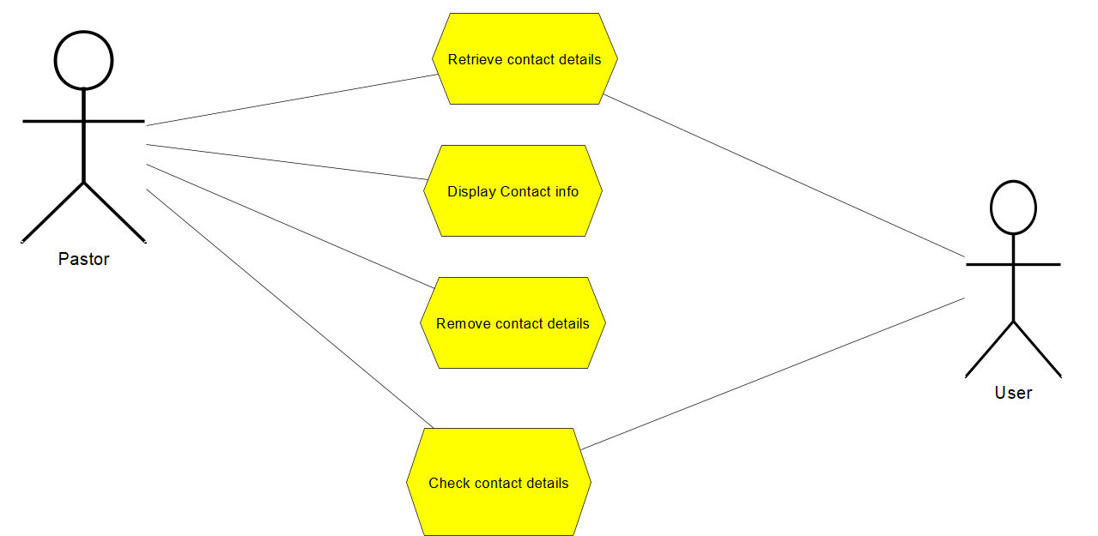

Slide 6
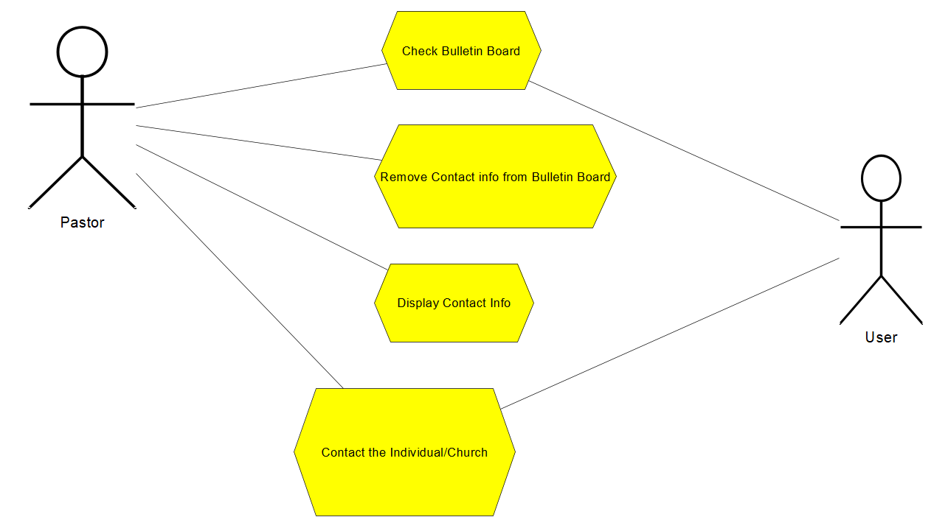

Slide 7
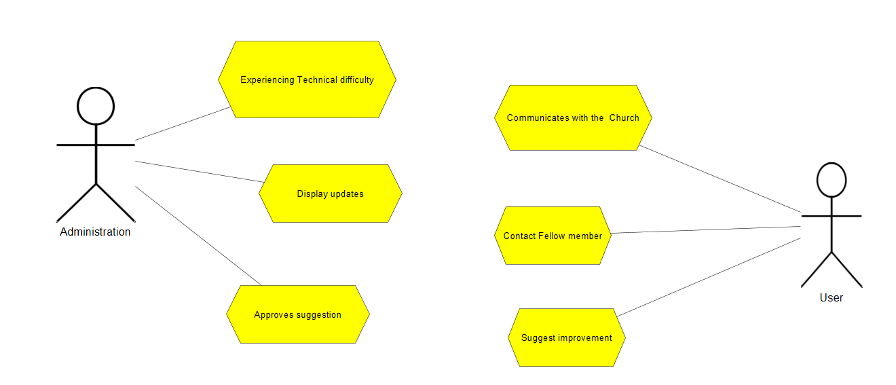

Slide 8
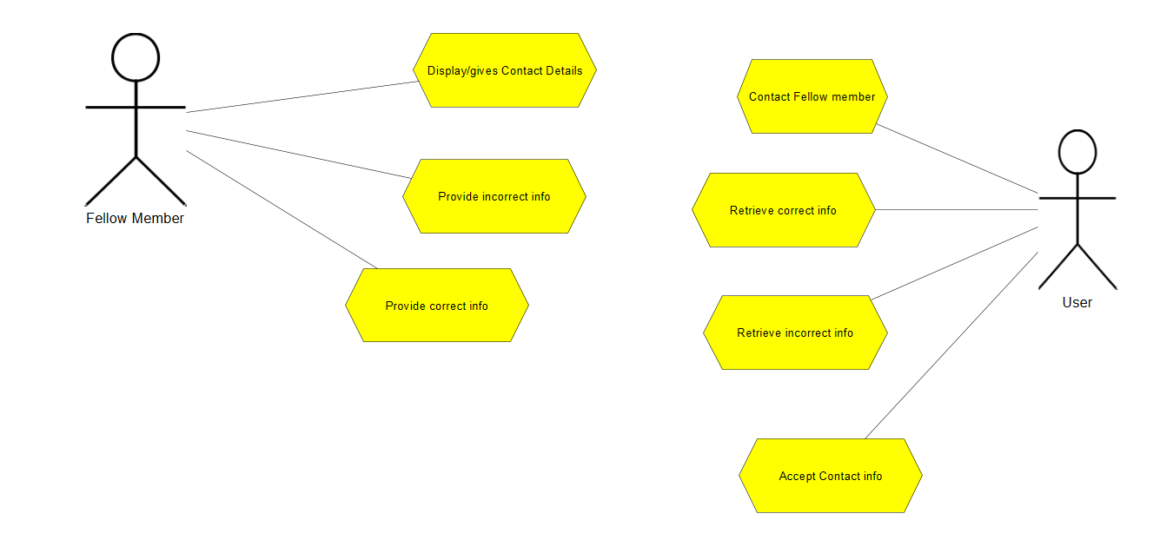

Slide 9
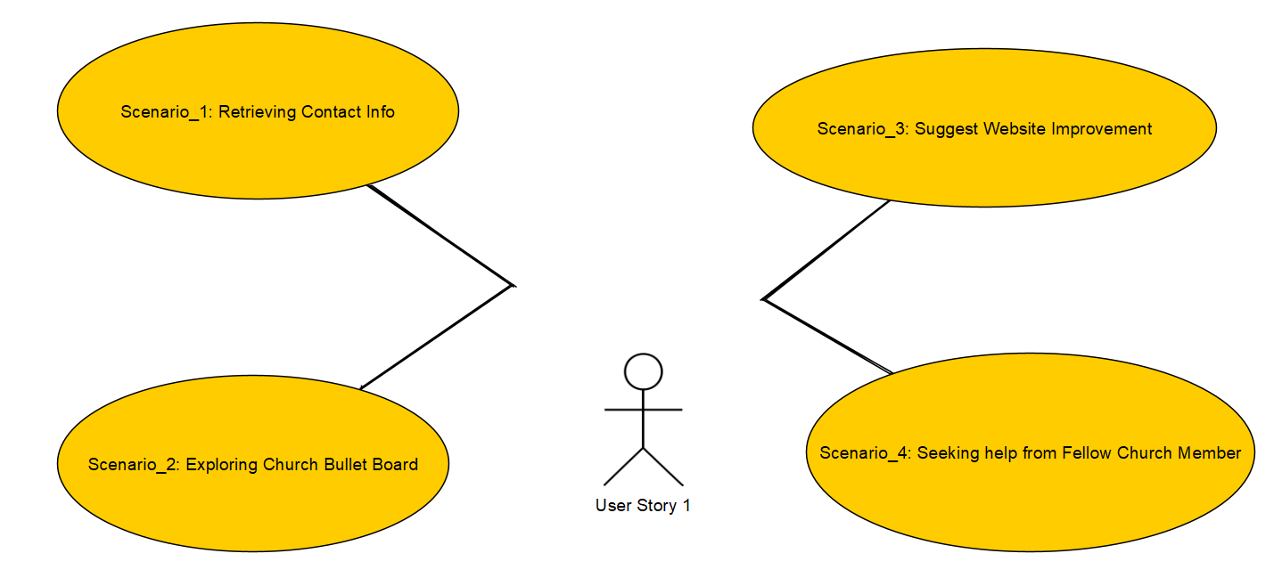
UML Diagrams for User Story 1

Slide 10

DATAbase structure

Slide 11
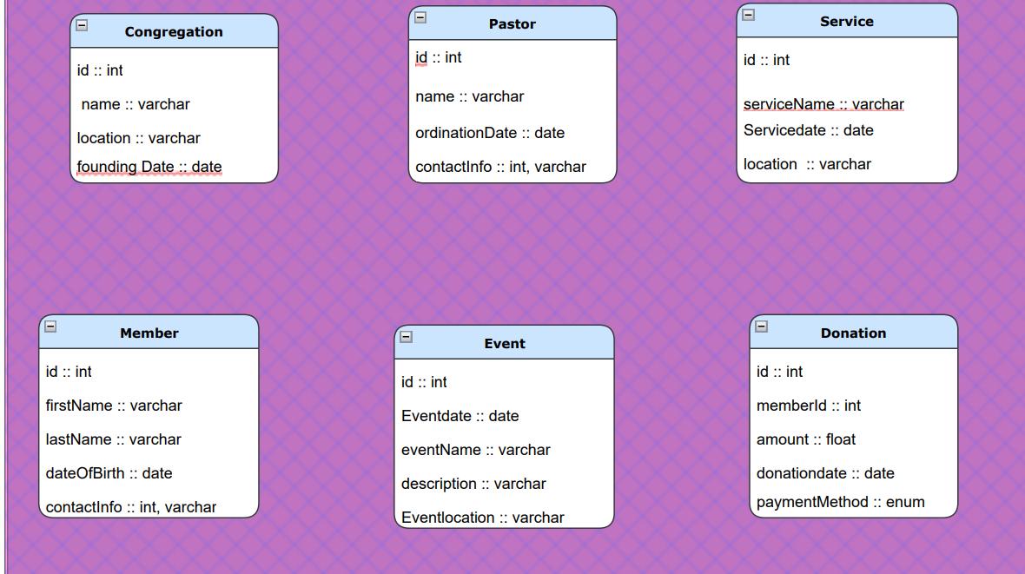

Slide 12
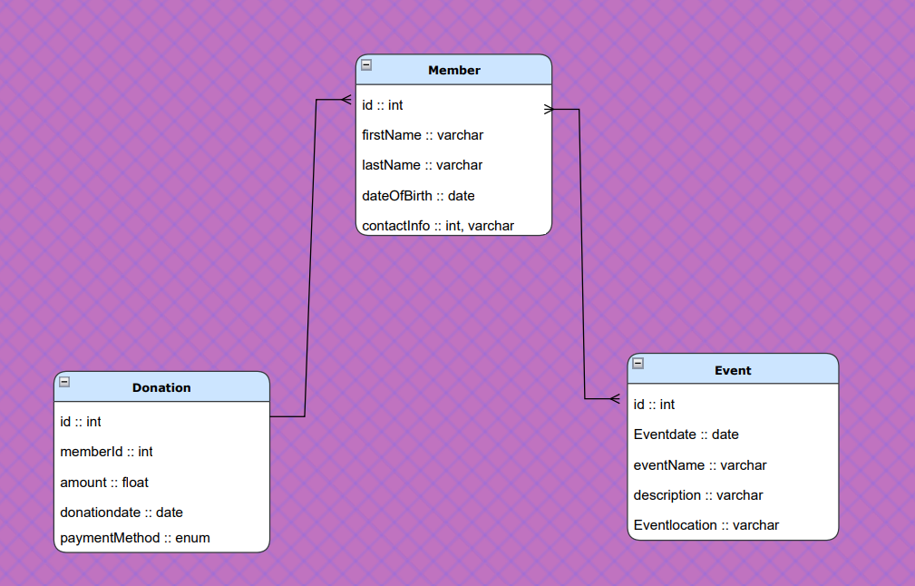

Slide 13
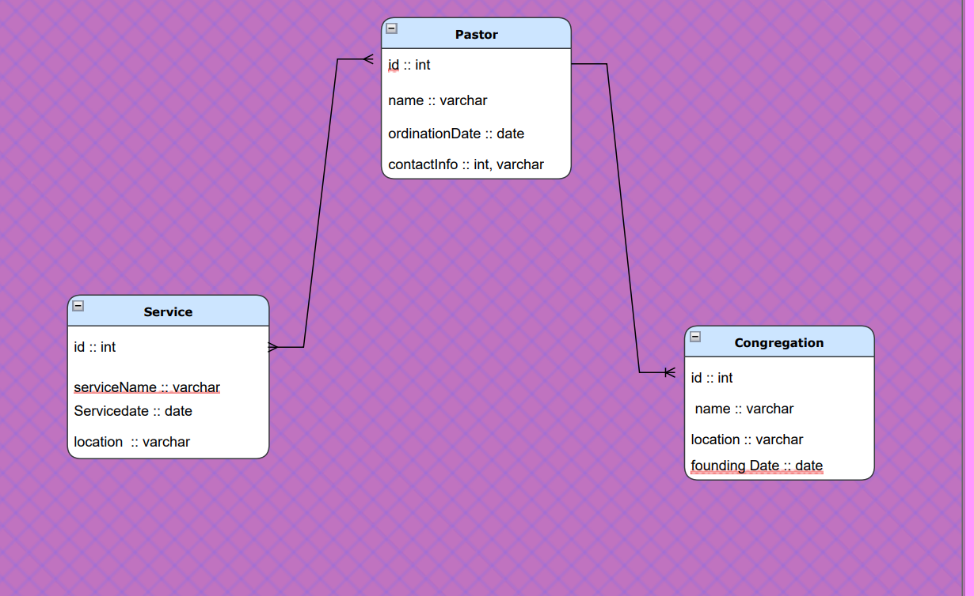

Slide 14

Click through Demo Design Mockups & Wireframes.drawio - draw.io (diagrams.net) HTML Design Published Design

Slide 15

THANK YOU

